Slide 1

BC2410, Prescriptive Analytics From Data to Decisions
Lecture 10

Slide 2
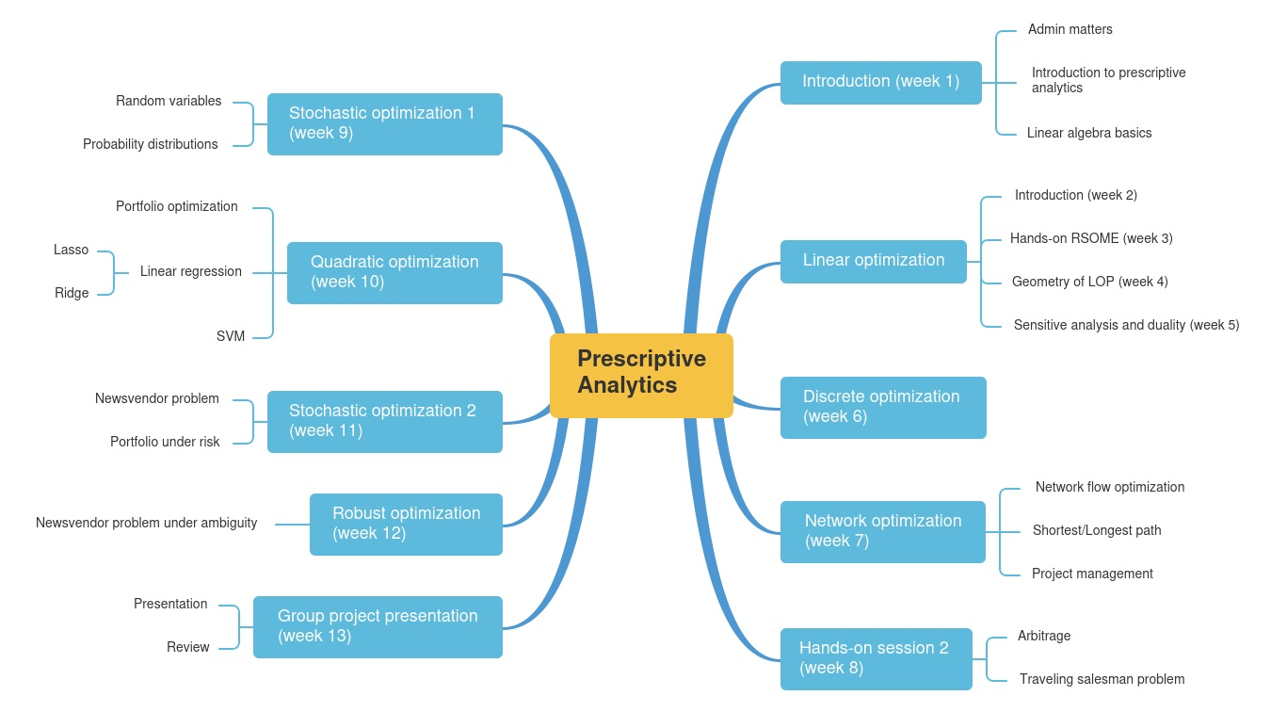
Schedule

Slide 3
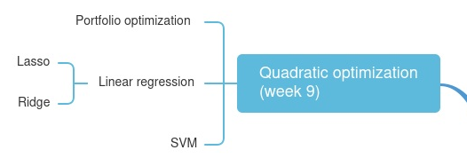
Schedule

Slide 4
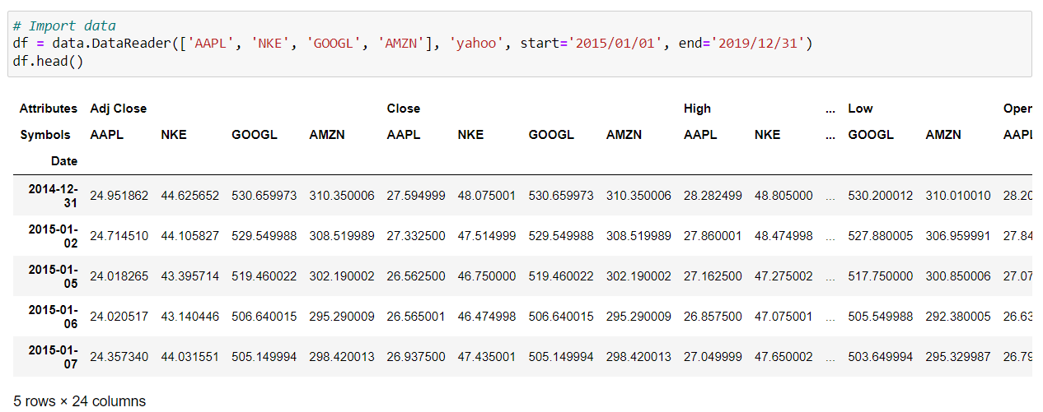
Real Data---Historical Data

Slide 5
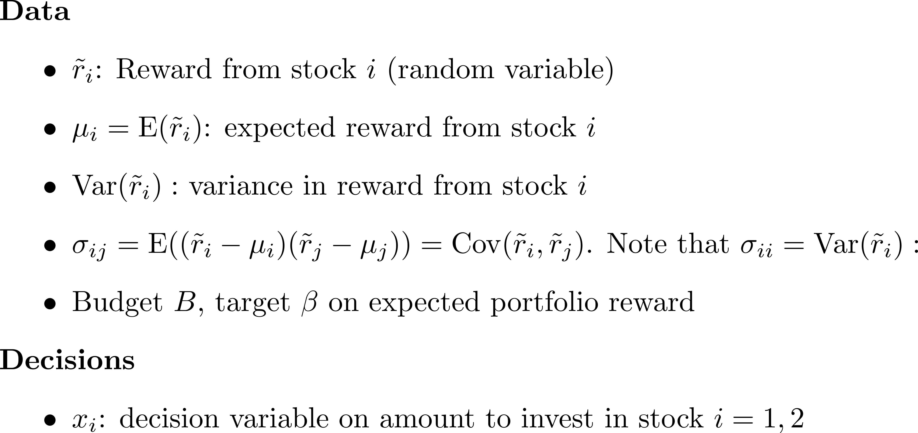
Classical Portfolio Selection

Slide 6
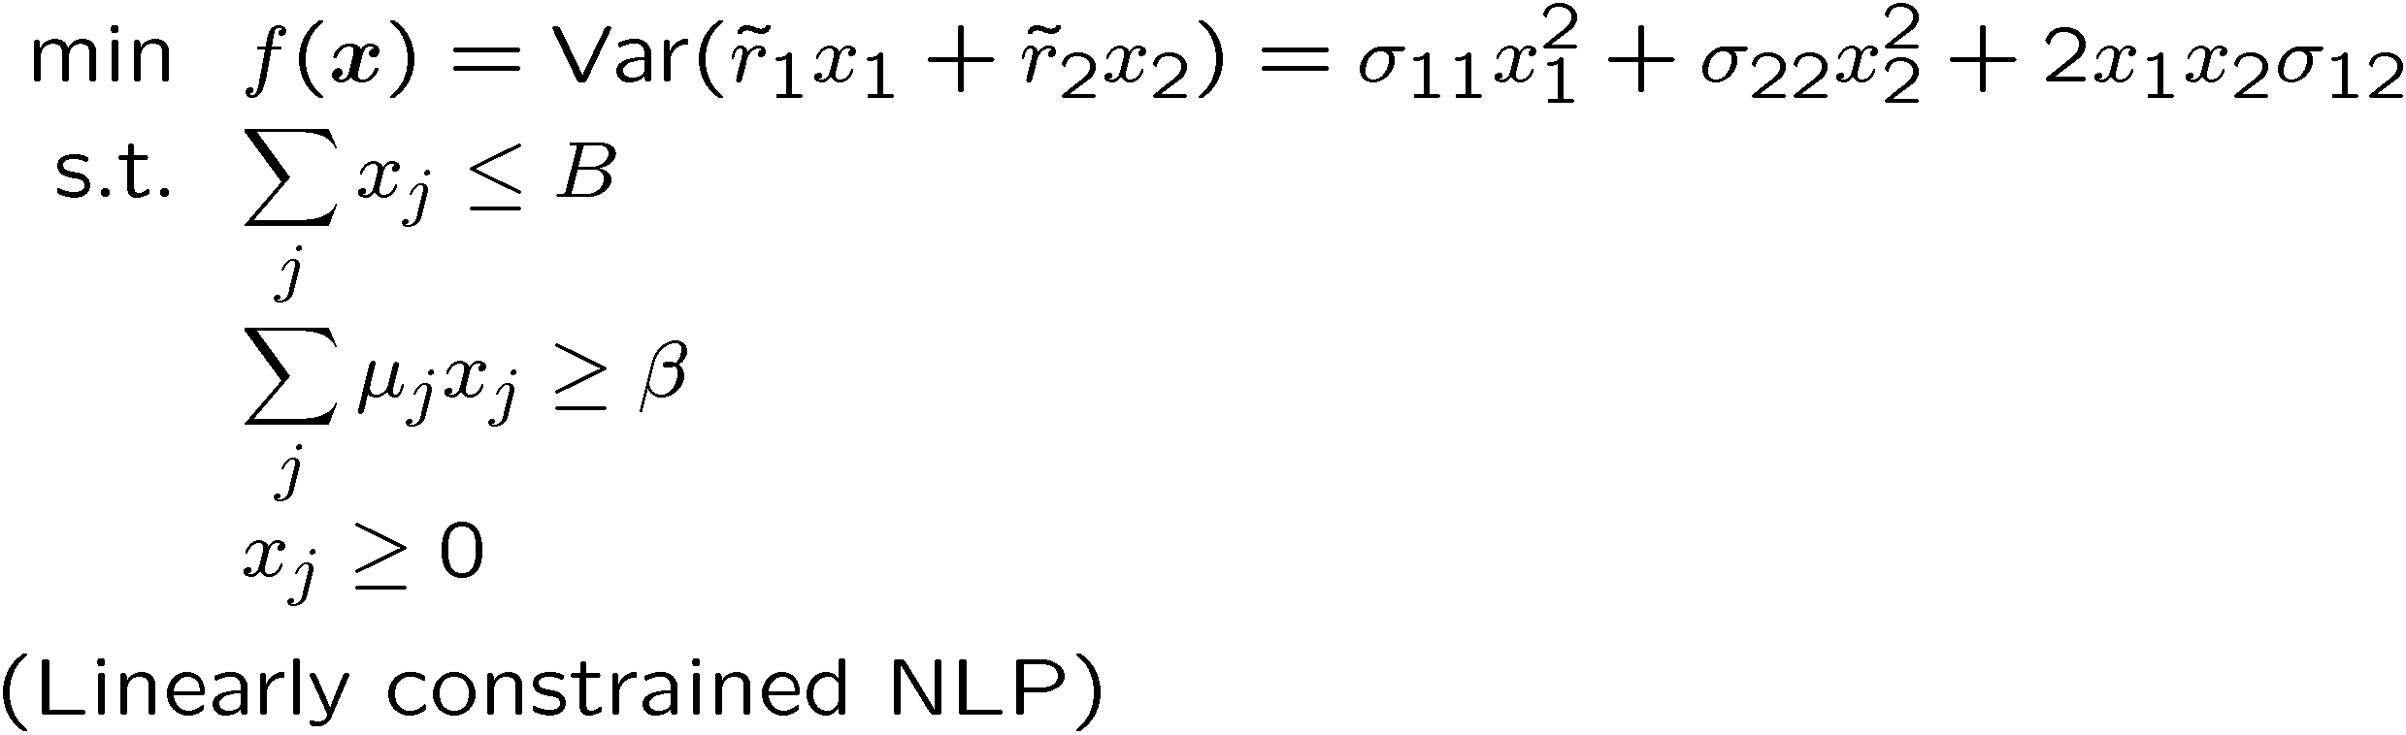
Markowitz Portfolio Optimization
Objective: Minimize total portfolio variance so that
Expected reward of total portfolio is above target β
Total amount invested stay within our budget
No short sales

Slide 7
Generalization of Portfolio Variance

Slide 8
Generalization of Portfolio Variance

Slide 9
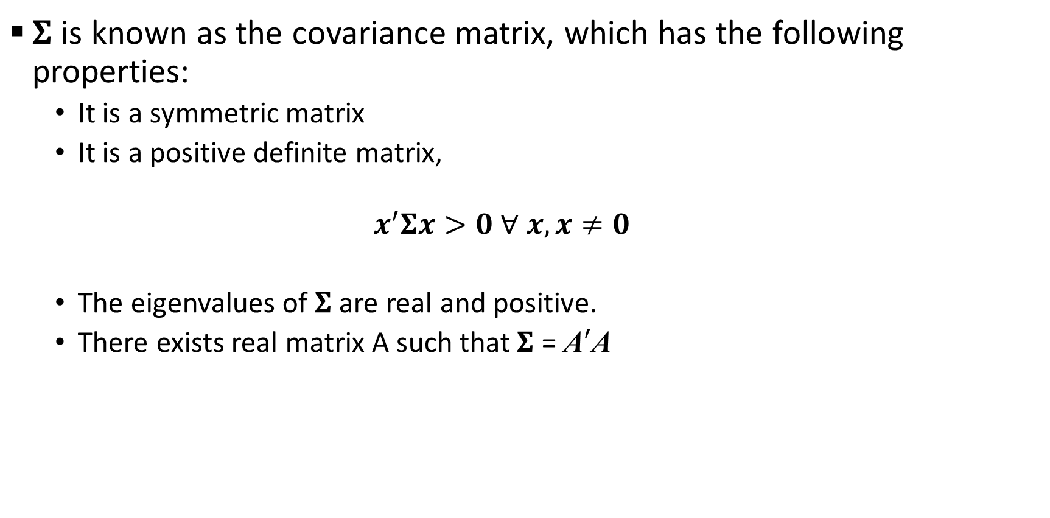
Generalization of Portfolio Variance
$Σ$ is known as the covariance matrix, which has the following properties:
It is a symmetric matrix
It is a positive definite matrix,
$$x^{′}Σx>0 ∀ x, x≠0$$
The eigenvalues of $Σ$ are real and positive.
There exists real matrix A such that $Σ$ = A$′$A

Slide 10

Covariance Matrix from Data
Let $X∈ℝ^{T×N}$ be a matrix that contains the stock returns of N stocks over T periods. In particular, $X_{tn}$ denotes the return of stock i at period t.

Slide 11
Covariance Matrix from Data

Slide 12
Compact form of Portfolio Selection Problem

Slide 13
Quadratic Optimization Problems

Slide 14
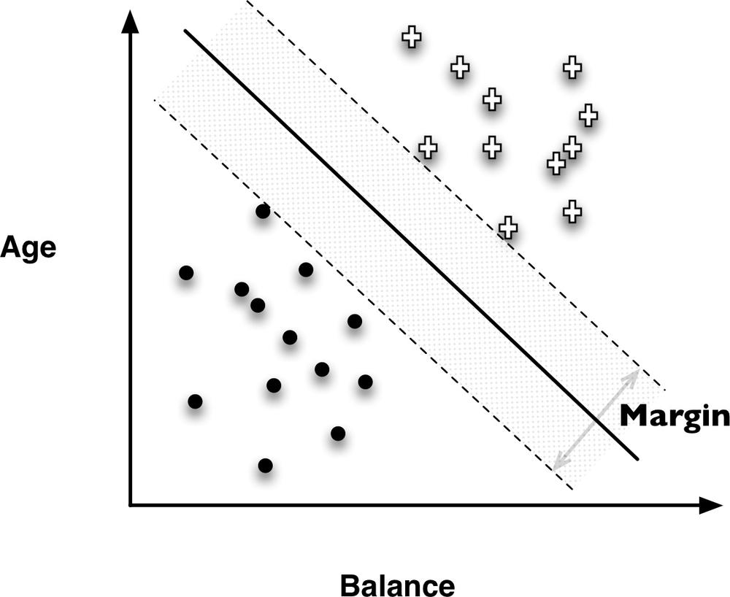
Linear classifier
Given m objects
The i-th object has an n-dimensional feature vector x_{i}
Objects belong to one of two classes, e.g., y_{i} = -1 or 1
We know the class that the i-th object belongs to
Linear classifier
Defined by an n-dimensional vector w and a scalar b
For a new object with feature vector x, the classifier declares it to be in
class -1: if
class 1: if
Linear classifier

Slide 15
Linear classifier
Suppose we want to find a linear classifier that gives the correct answers for all existing objects
Let S be the set of objects in class -1
We look for some vector w and a scalar b that satisfy the constraints
Strictly inequality is not of the form in linear program

Slide 16
Linear classifier
In fact, we can see that is equivalent to
for a very small
Since we can always scale w and b simultaneously, we can scale them by and have the constraints:
Looking for w and b is to solve a feasibility problem
With a null objective, e.g., max/min 0 subject to the constraints above

Slide 17
Support Vector Machine
Support vector machines (SVM) is a linear classifier.
Classifies instances based on a linear function of the features
Objective function based on a simple idea: maximize the margin
Fit the fattest bar between classes
Once the widest bar is found, the linear discriminant is the center line through the bar
The margin-maximizing boundary gives the maximal space for classifying new points.
Support vectors
Notes:
min |w|, s.t., y_i*(x*x_i-b)>=1, for all i

Slide 18
Support vector machine
Training dataset:
Find a hyperplane such that
When the objects are perfectly separable, the optimization problem is
Quadratic optimization

Slide 19
Support Vector Machine
Introduction to SVM:
https://youtu.be/Y6RRHw9uN9o
Optimization formulation for SVM
https://youtu.be/IOetFPgsMUc

Slide 20
Linear Regression
Given n data points (x₁,y₁), (x₂,y₂),…,(x_{n},y_{n})
For i-th sample, the feature vector x_{i}=(x_{i1}, x_{i2}, … , x_{ip})
The feature vector is p-dimensional
We fit a linear model
Simple linear regression finds the coefficients by solving the optimization problem

Slide 21
Regularization
However, simple linear regression tends to overfit by involving too many features in the prediction.
Parameter optimization in linear models
Choose the right set of features
f (x) = w₀ + w₁x₁ + w₂x₂ + …
Regularization: combined optimization of fit and simplicity
Models will be better if they fit the data better and if they are simpler

Slide 22
Ridge Regression
Penalty on the sum of the squares of the coefficients
The optimization problem becomes
Sum of squares given a large penalty when weights have large values
Square of L2-norm + standard least squares linear regression = ridge regression
Introduction to ridge regression: https://youtu.be/Q81RR3yKn30

Slide 23
LASSO
LASSO=“least absolute shrinkage and selection operator”
Penalty on the sum of the absolute values of the coefficients
The optimization problem becomes
Zeroes out many coefficients → feature selection
L1-norm + standard least squares linear regression = lasso
Introduction to LASSO: https://youtu.be/NGf0voTMlcs

